Slide 1
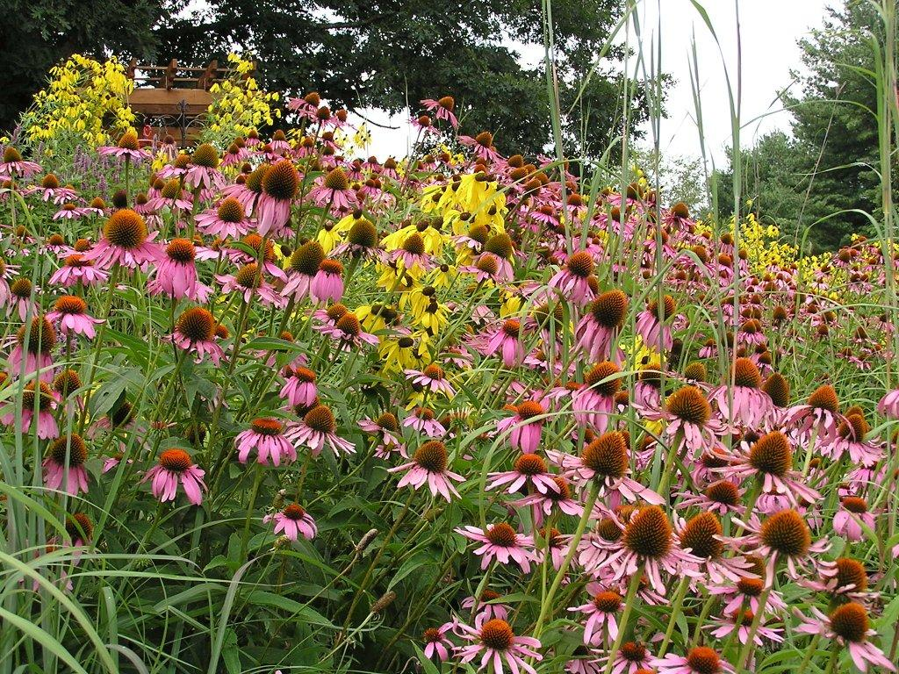
Landscaping With Native Plants
Mike Larrivee

Slide 2
Everyone loves nature, right?

Slide 3
This guy (Burton)
← “Indoorsy”
Allegedly…

Slide 4
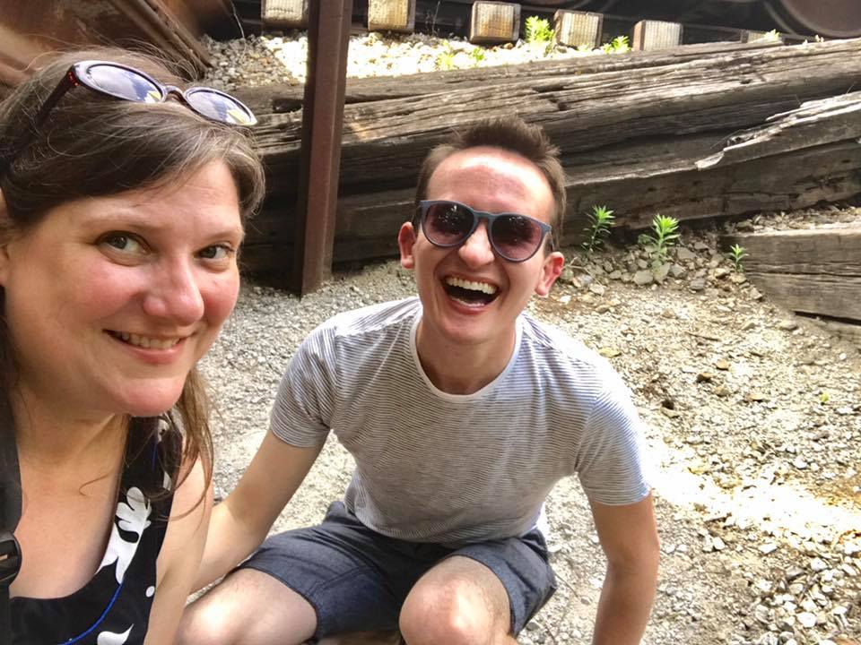
However;
← Drink

Slide 5
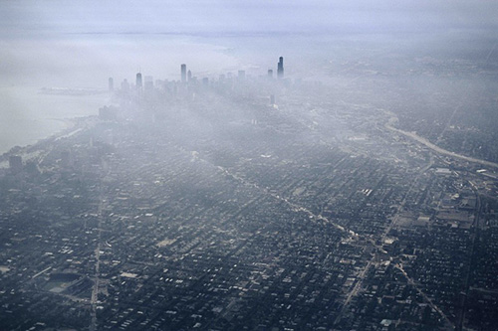
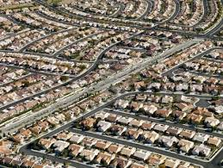
So what’s going on with our nature here in the US of A?
Urban centers are growing
Sprawl has converted more than 150 million acres in the past 50 years

Slide 6
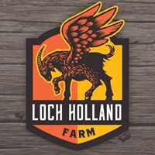
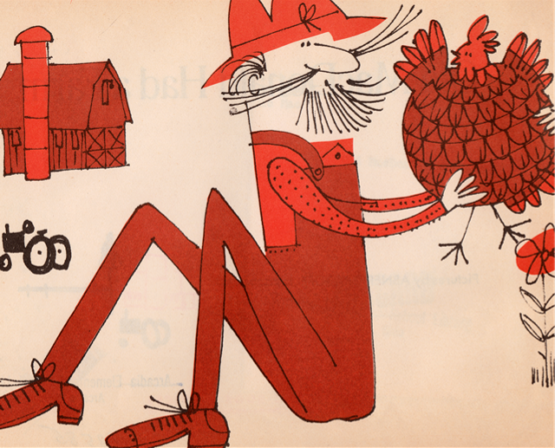
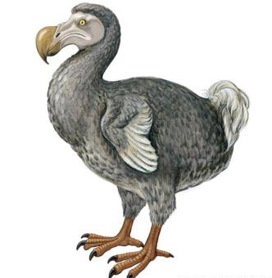
Old McDonald has largely gone the way of the Dodo
Cooper-Young Farmer’s Market every Saturday from 8AM-1PM

Slide 7
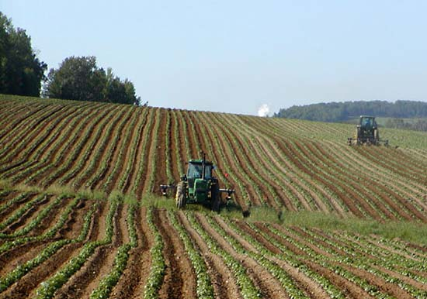
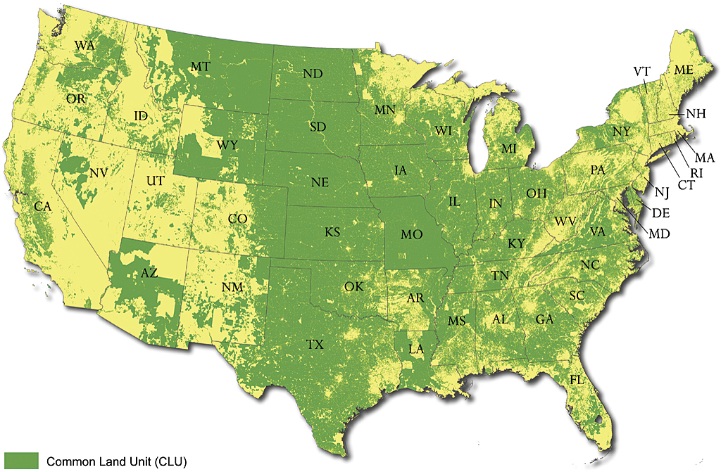
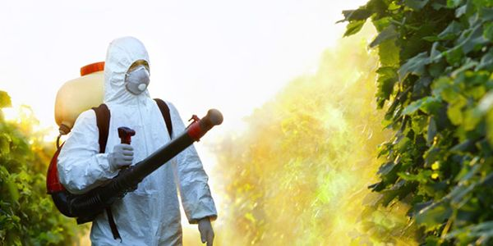
To the tune of more than
40%
of our landmass
And been replaced by commodity agriculture
that creates ecological deserts through the use of harsh synthetic chemicals and monocultures

Slide 8
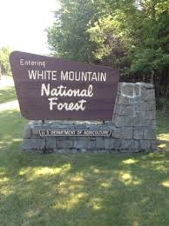
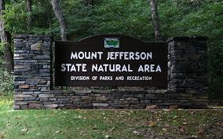
So what’s left?
A National Forest
About 12% of our land is considered a “Natural Area” such as:
State Natural Area
or Scenic Waterway

Slide 9
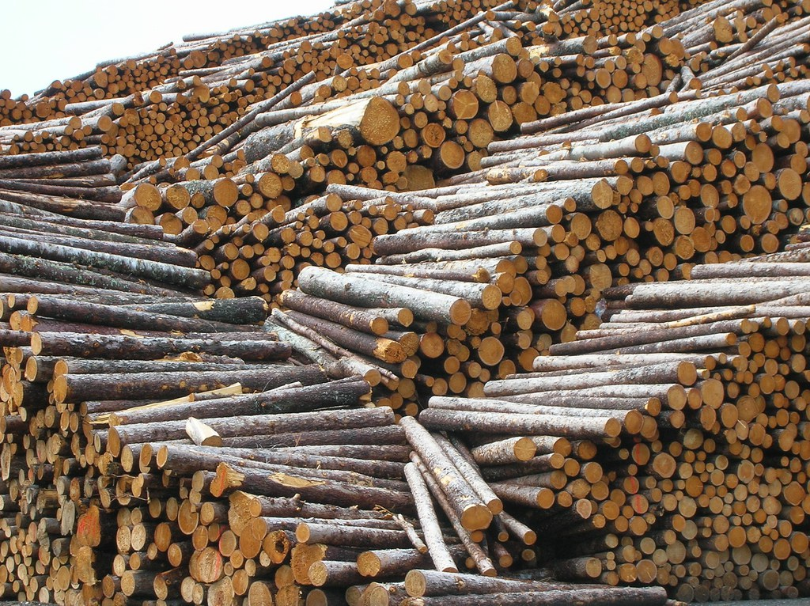
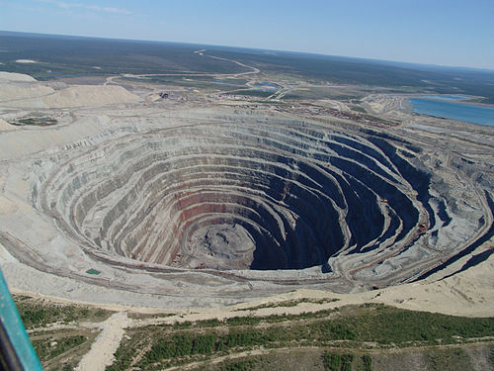
More than half of that is currently open to logging, mining, and other extractive activity.

Slide 10
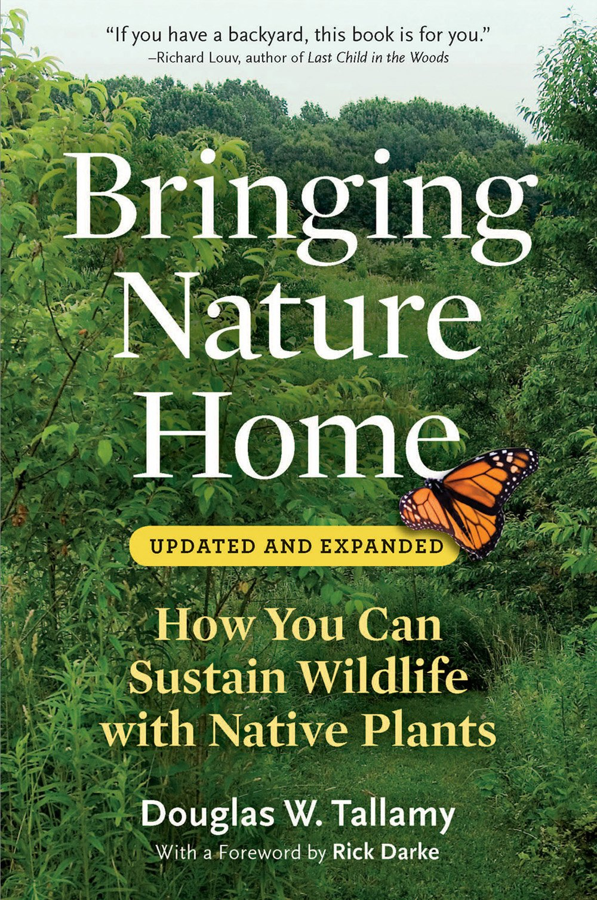
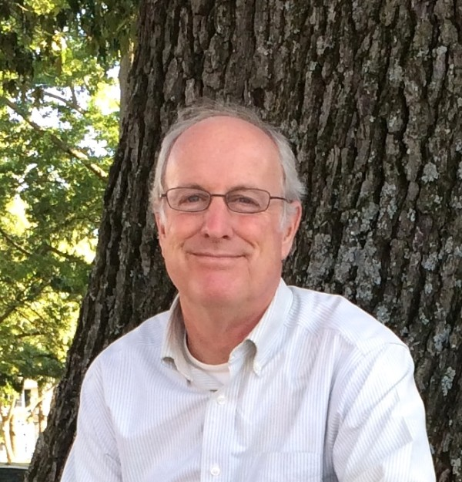
So, only about 5% of our fractured and divided wildlands remain intact. We, the private property owners, are the ones that need to be
Nerd Crush
← I THIS GUY

Slide 11
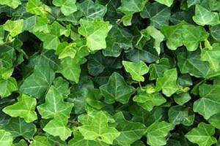
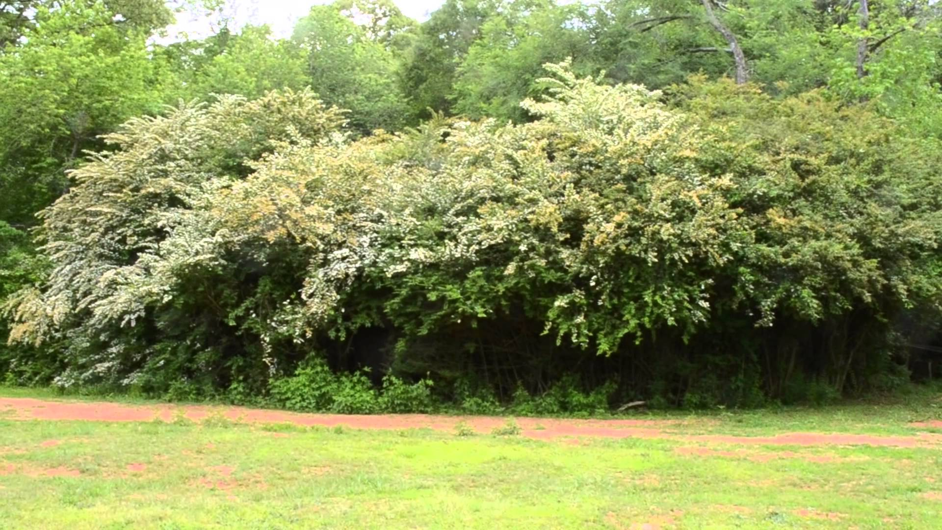
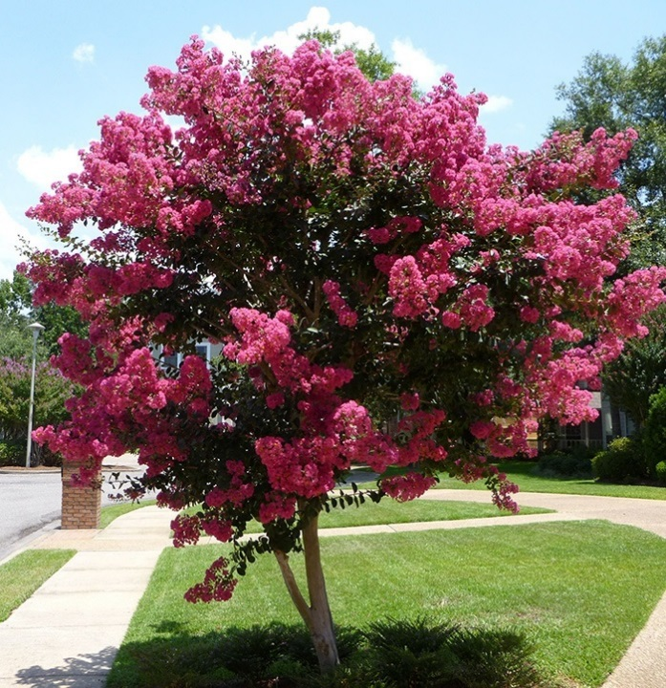
What can we do?
Stop planting “Green Statues”
English Ivy
(Audience Boos Again)
like Chinese Privet
(Audience Boos)
and Crepe Myrtle
(Audience Boos Yet Again)

Slide 12
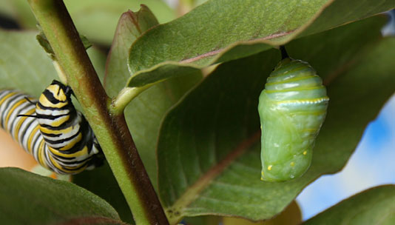
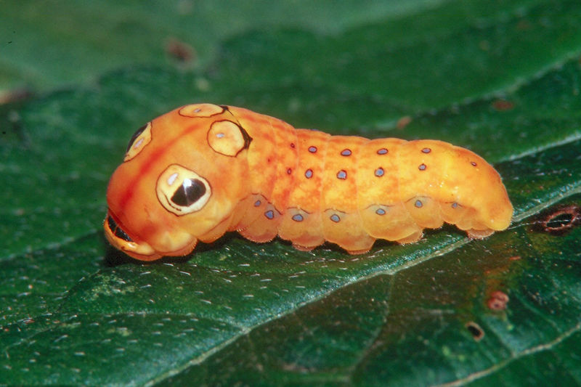
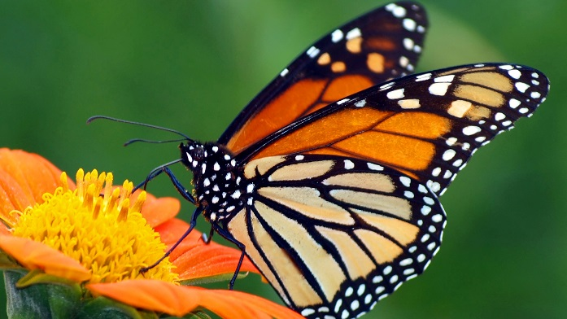
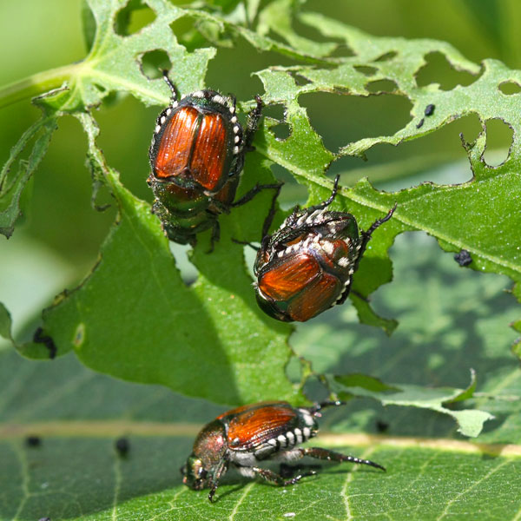
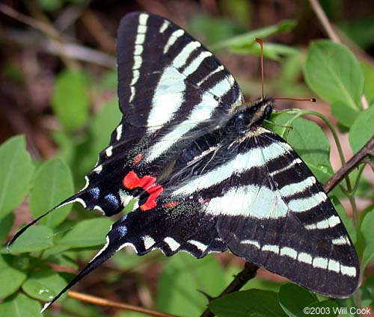
Green Statue = Exotic Plant
Evolved elsewhere, without the plants and animals in our community.
Does not cycle nutrients up through the food web, often marketed as “Pest Free.”
Most insects are specialists:
Monarch = Milkweed
Zebra Swallowtail = Pawpaw
Not generalists, like these guys.
Also exotic

Slide 13
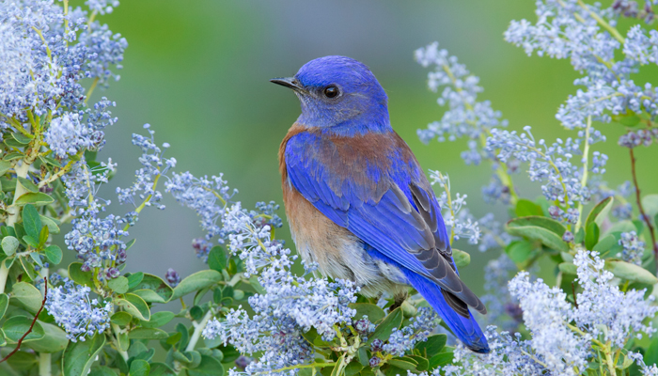
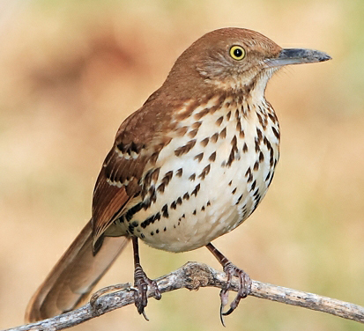
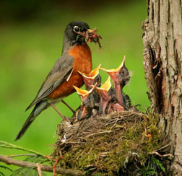
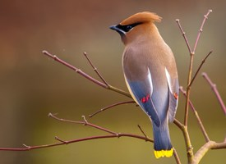
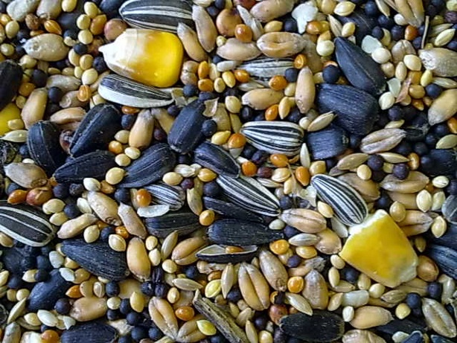
Ok, so you don’t like butterflies…
What’s wrong with you???!!
How about
birds?
95% of a baby bird’s diet comes from this,
not this.
How about everything else?

Slide 14
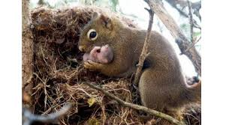
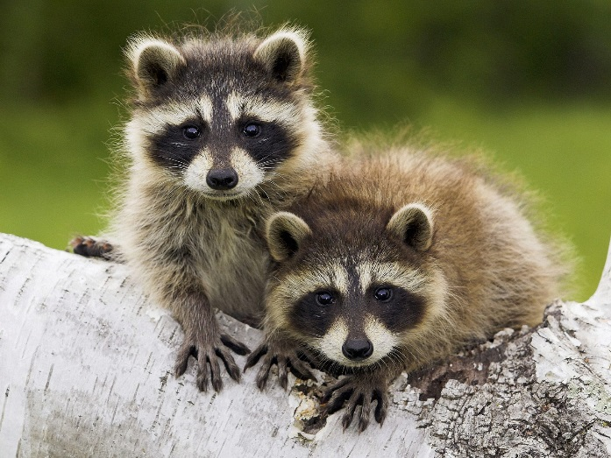
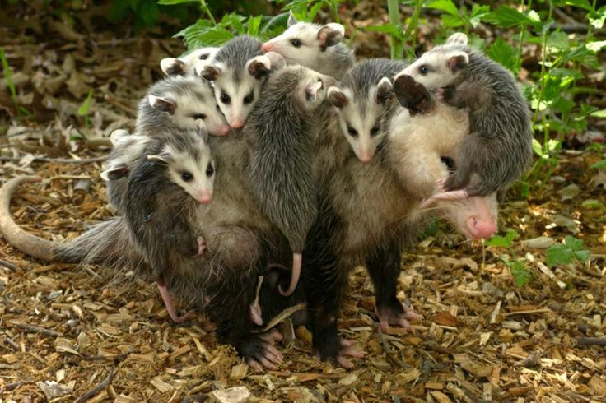
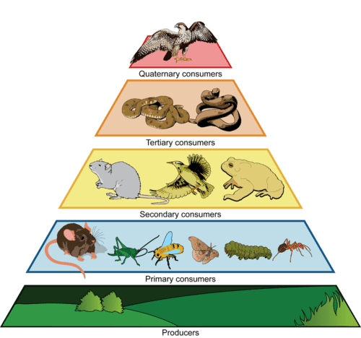
Plants are the “producers” at the base of the food web receiving energy from the sun.
US.
All life on earth depends on the cycling of nutrients
through the trophic layers, including

Slide 15
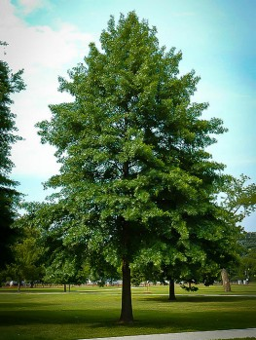
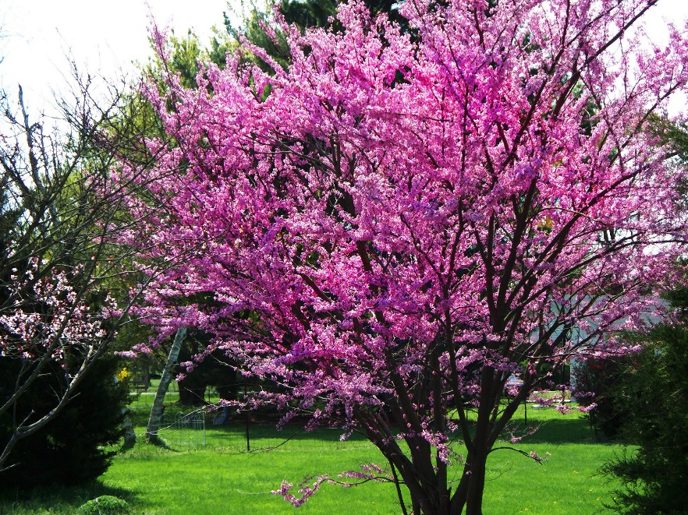
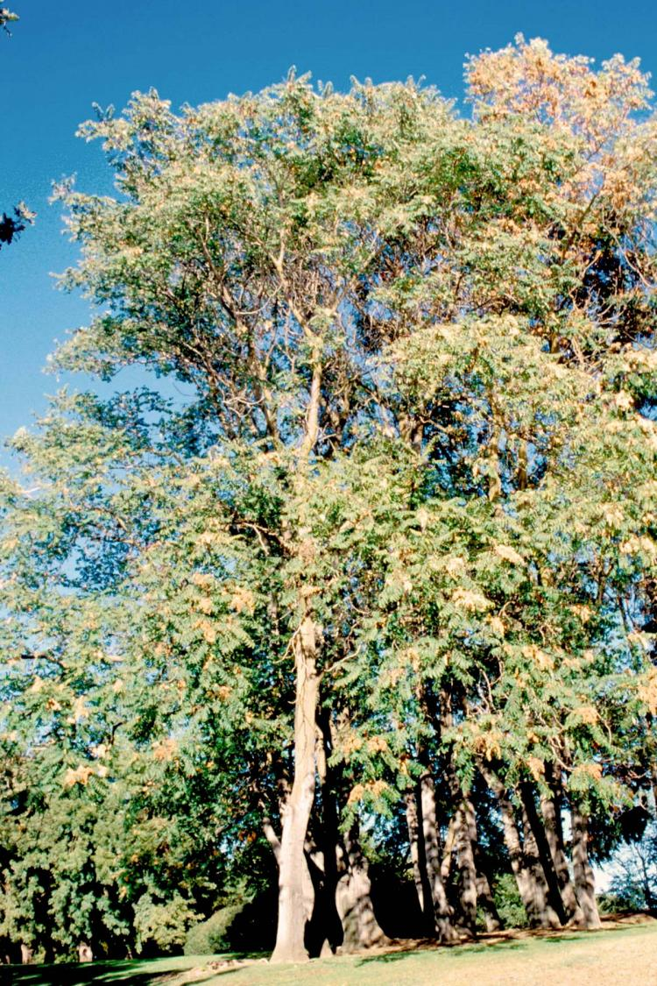
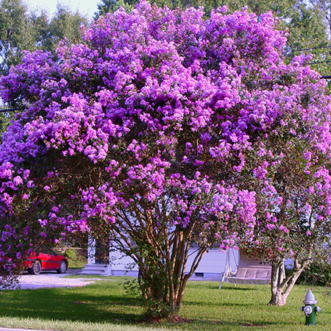
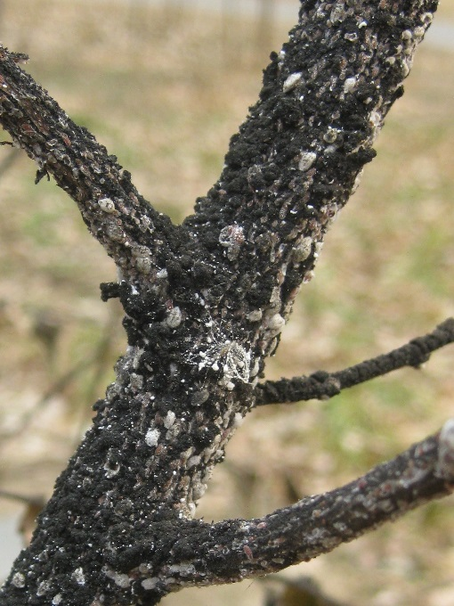
So the next time you plant a tree, maybe consider this
Instead of this
Or this
500+
Instead of this
0
135
0
Crepe Myrtle Bark Scale = RIP Tree

Slide 16
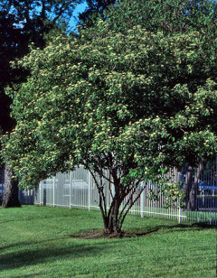
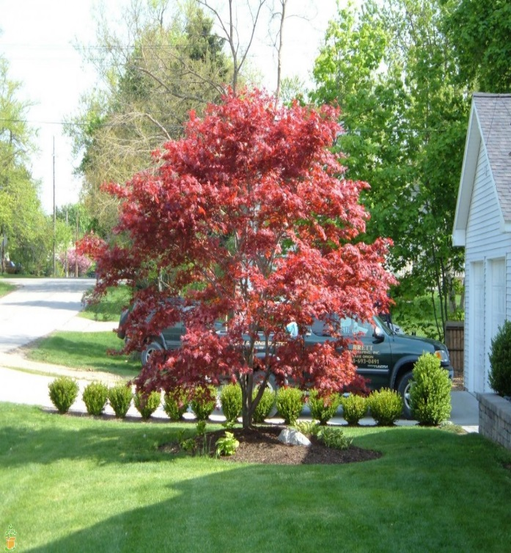
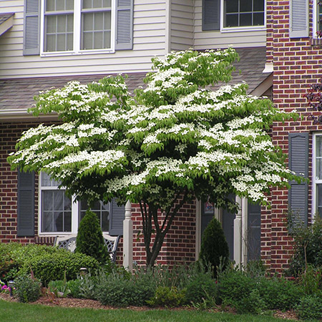
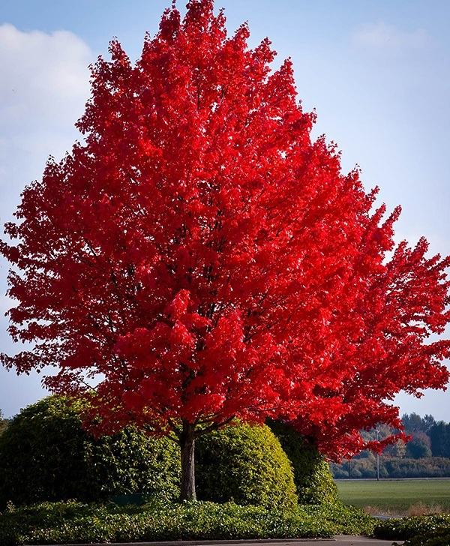
Here’s where it gets a little tricky:
Maples
117
0
0
235
Dogwoods

Slide 17
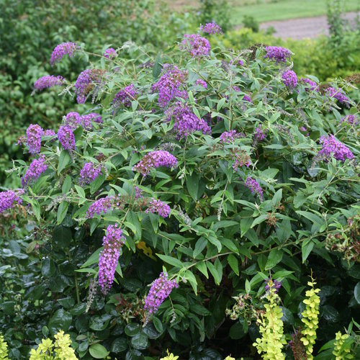
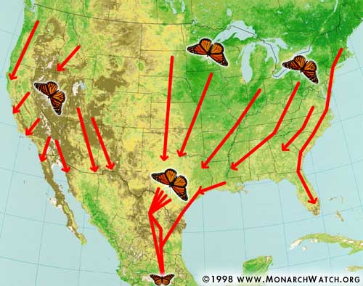
Butterfly Bush = Great nectar source + longstanding blooms
But migrating pollinators need fat, not sugar for their long trip south.
Our well intentioned “pollinator plants” are inadvertently starving our butterfly friends. ☹

Slide 18
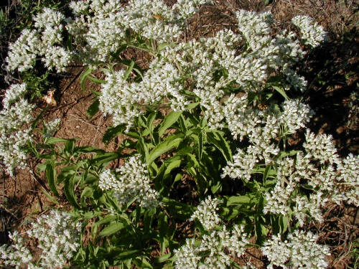
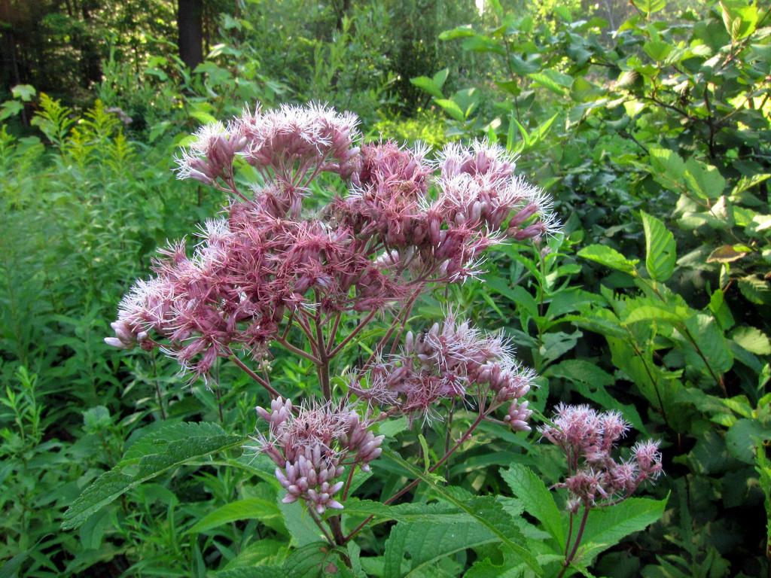
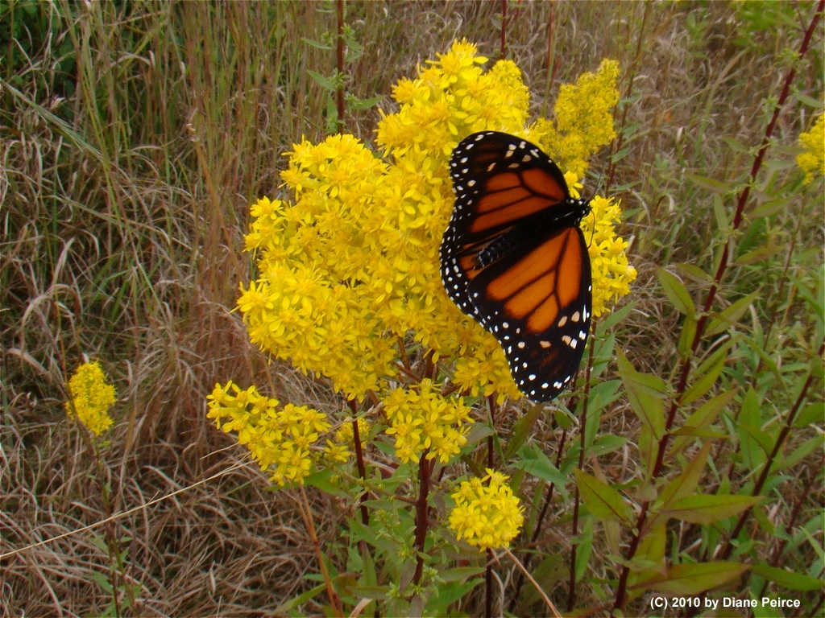
Plant these instead:

Slide 19
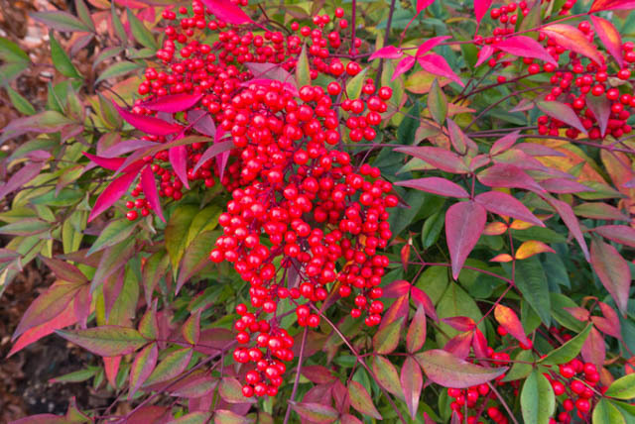
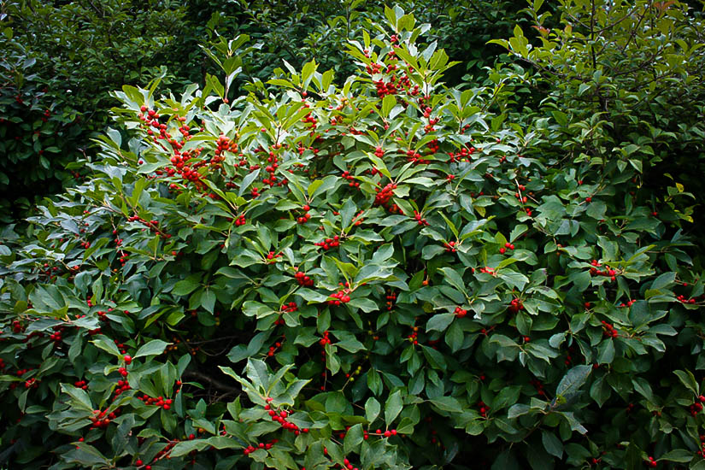
Nandina: Invasive Exotic Murderer of Cedar Waxwings
Winterberry Holly: Food for Cedar Waxwings

Slide 20
Now, it’s time to play a game called:
Or hit me here:
https://www.facebook.com/mike.larrivee
Stump the Hippie Scientist
What’s in your yard? What exotic plant can you not live without?
Hit me!
I can give you a native that will not only perform the same function in your landscape…
But it will thrive in the same site with less time & attention, less water, and less work.
THANK YOU FOR COMING!!

